Slide 1
Production of Compactainer
Capabilities Required for the production of KHW Compactainer
Tube processing, including cutting, bending
Wire processing, including cutting bending
Assembly welding, using either manual or robot welding (MAG)
Electrogalvanization, process in which a layer of zinc is bonded to steel in order to protect against corrosion. The process involves electroplating, running a current of electricity through a saline/zinc solution with a zinc anode and steel conductor

Slide 2
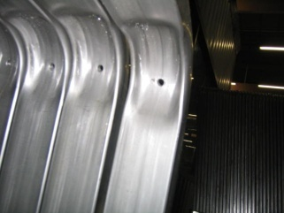
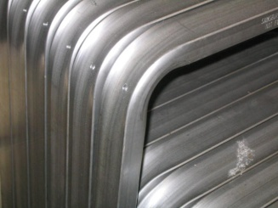
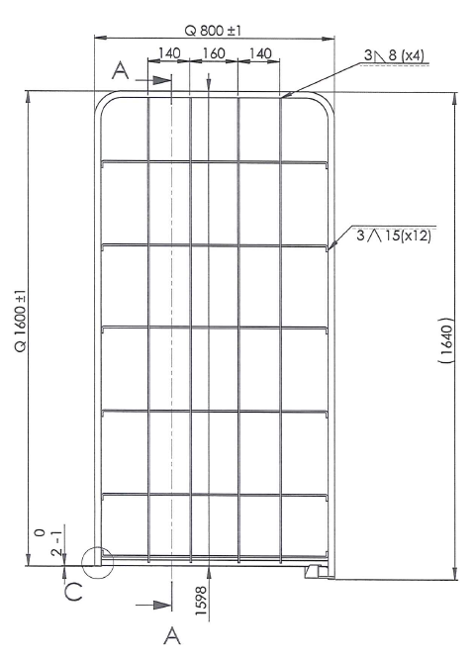
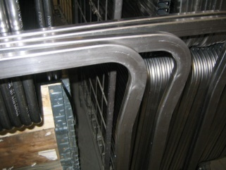
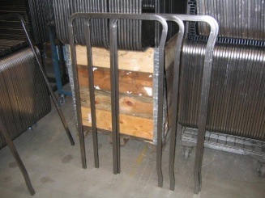
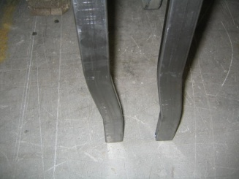
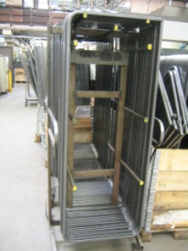
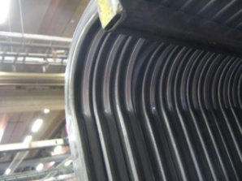
Tube Bending
Tube bending / Required machinery
Example of K.Hartwall’s bending requirements for tubes, with general requirement to be able to bend with double head machine “2 times * 2,0 * 40mm” round tube or alternatively “2 times * 1,5 * 30mm” square tube
Example Precision tube 50x25x2,0, E220H with Bending radius R = 45mm inside
Example of Precision tube 30x15x1,5 E220C with bending radius R = 40mm inside
Example of Precision tube 19x19x2,0 E220C, with bending radius R = 50mm inside
Other include e.g. Precision tube 22x22x1,65 E370C, with bending radius R = 70 mm inside, Precision tube ø20x1,5 E220C, with bending radius R = 40 mm inside

Slide 3
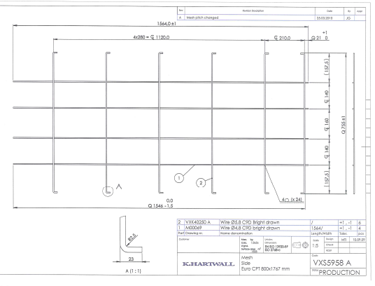
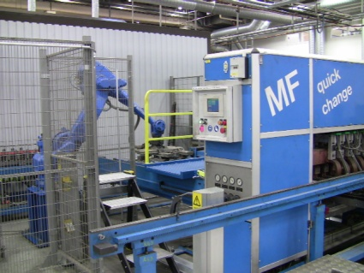
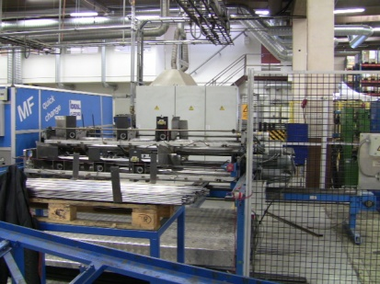
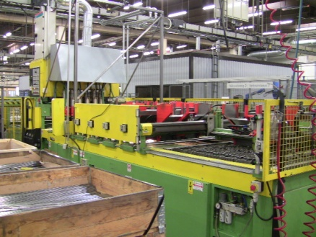
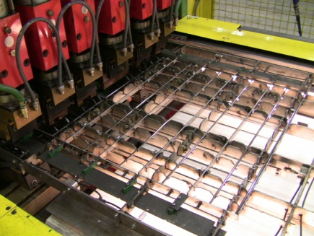
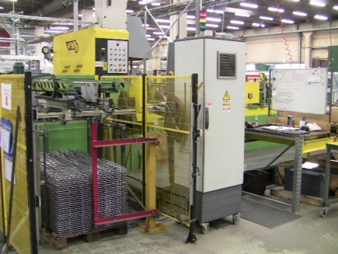
Wire mesh welding
Wire mesh welding / Required machinery or capabilities
Mesh welding robots e.g.
IDEAL, SCHLATTER, VARO, CEMSA
Other Requirements & Specifications
Wire dimension 2-8mm
Maximum size of the mesh lenght 2000mm, width 1500mm and with minimum mesh of 25x25mm
Example

Slide 4
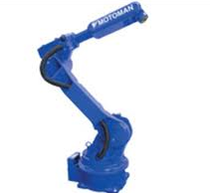

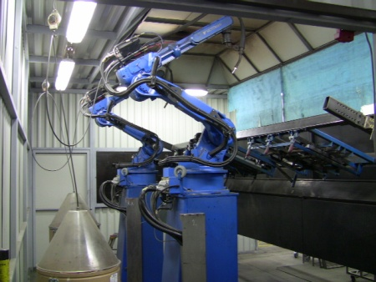
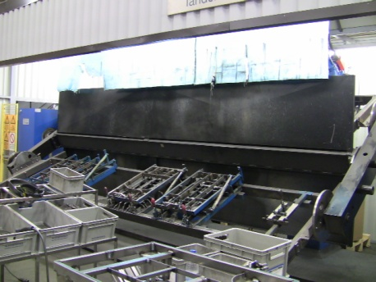
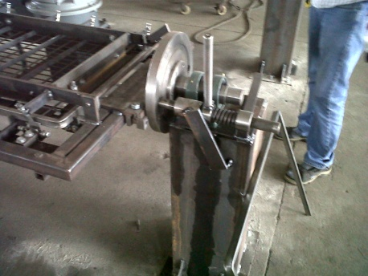
Welding of Roll cage products
Assembly Welding / Required machinery or capabilities
Single, double or triple head robot welding machine equipment, with e.g. one of welding robots mentioned below and a turning table where possible
Motoman HP20D-6
Motoman MA1900
(Motoman MA1800)
OTC AII-B4L
OTC AII-V6L
Other Requirements & Specifications
Dimensions of the welding table with width min 3,5m, depth min 1,25m (e.g. Type RM2-750)
Welding equipment 350 amper
Water cooled welding nozzle (if possible)
Welding nozzle cleaning station (recommended)
Welding gas CO2 or Arcon+CO2
Example of double head welding station with turning table (Motoman)
Example of triple welding station with turning table (Motoman)
Example of welding turning table (manual)

Slide 5
Surface Treatment of Roll cage products / Electro plating
Electroplating (“Electrogalvanization”) in General
Electrogalvanization is a galvanization process in which a layer of zinc is bonded to steel in order to protect against corrosion. The process involves electroplating, running a current of electricity through a saline/zinc solution with a zinc anode and steel conductor
KHW requirement for Electroplating
KHW requires an electroplating based on requirements
Electroplating: EN12329:2008
Topcoat: Lacquer/sealer
Quality Control by Salt Spray Tests: ISO 9227 (min. 96/144 hours)
Bath sizes should be minimum 2m depth, 800 wide and 3-6 meter long, to fit products with sizes e.g. 800mm wide x 1800mm long x 300mm width
Electroplating of KHW components are done according to the standard EN12329:2000. Typical requirement of for KHW Products electroplating is Fe/Zn12/A; which means:
Fe = base steel material to be electroplated
Zn12 = zinc layer on top of the steel, layer thickness 8-12 microns
A = code for the chromate type, bright
This specification is marked on the assembly drawing and is specified individually for each type of Product
More detailed information of the electroplating requirement can be found on the standard mentioned earlier,
EN12329:2000.
One basic exception compared to standard EN12329:2000 is that K.Hartwall is using only 3-valent chromium (Cr3⁺) in blue passivation. K.Hartwall requires this also from its partners making electroplating.

